Slide 1
Theatre in America
An Overview

Slide 2
1700’s t0 1800’s
Theatre in America was mostly imported from Britain in the 1700’s through the early 1800’s.
Shakespeare and Restoration writers Sheridan and Goldsmith were most popular
Many theatres were closed in the Massachusetts area due to Puritan influence after the Revolution.
In the mid- 1800’s melodrama and Minstrel shows were the most popular. “Uncle Tom’s Cabin” was a huge success in the north in the 1850’s.

Slide 3
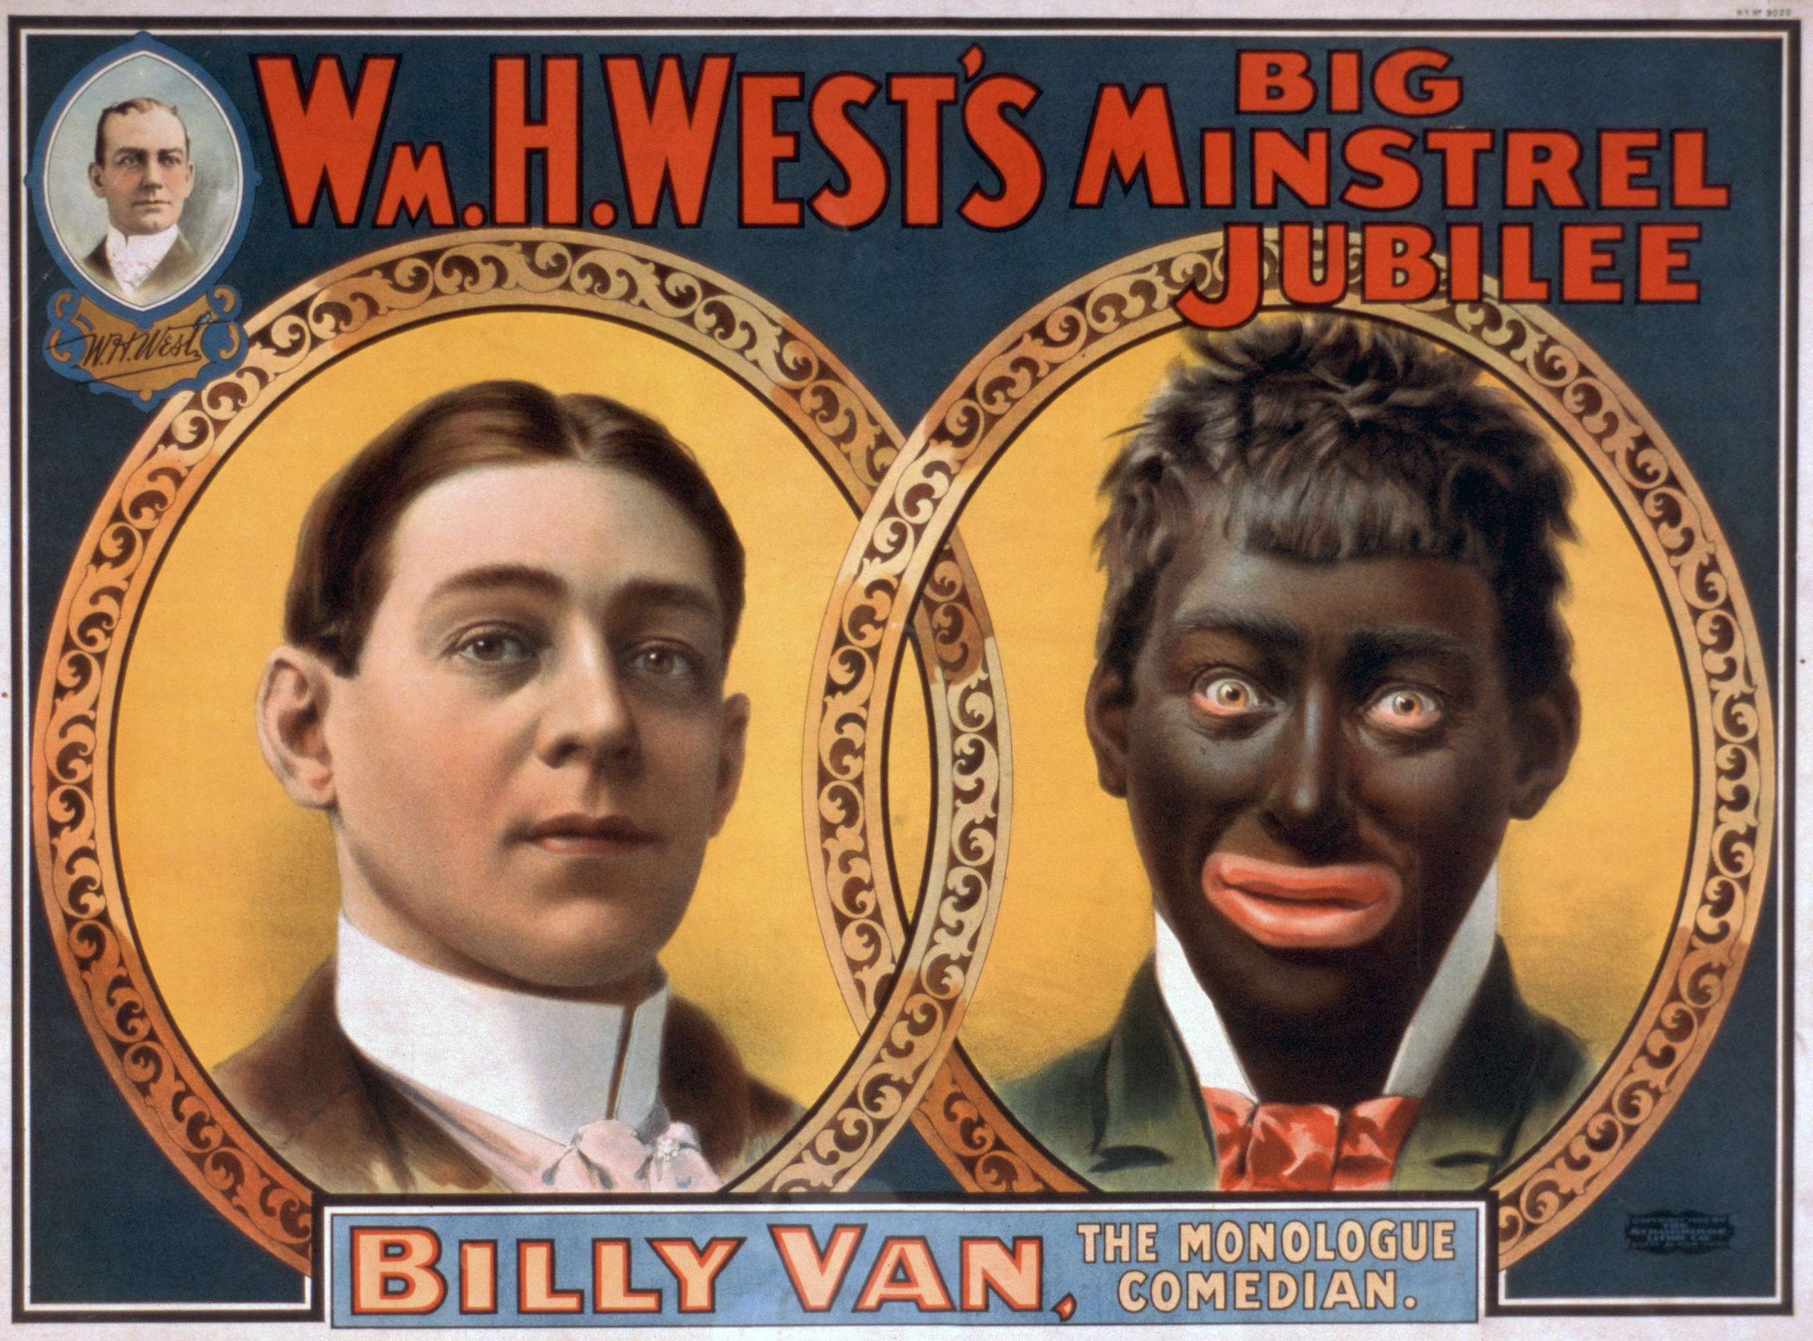

Slide 4
1860-1900
John Drew, Edmund Kean and The Booth Family were large stars in American Theatre. Junius Brutus Booth, Edwin Booth and of course John Wilkes Booth best known for assassinating Abraham Lincoln.
The Barrymores – John, Ethel, and Lionel and their offspring ruled the American Stage and then early film in the late 1800’s – 1930’s
John Barrymore Jr. and his wife the daughter of John Drew is the father of Drew Barrymore.

Slide 5
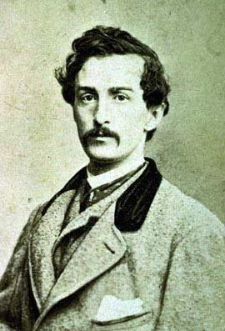
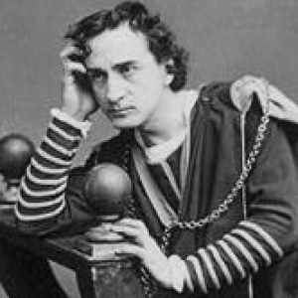
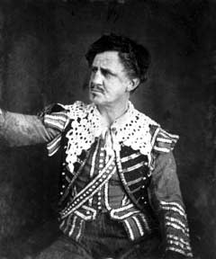
John Wilkes Booth
Edwin Booth
Junious Booth

Slide 6
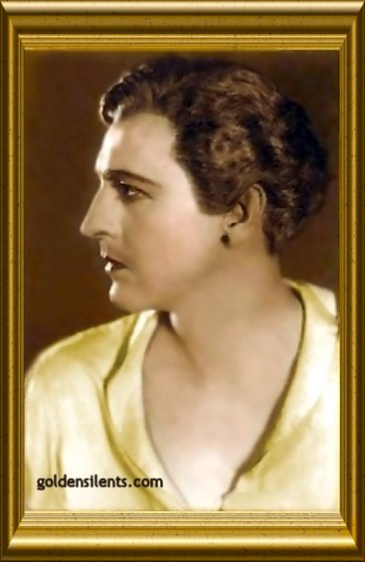
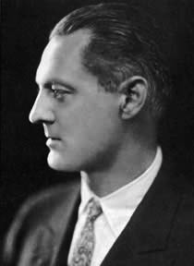
Lionel Barrymore
John Barrymore

Slide 7
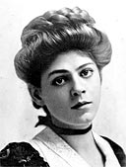
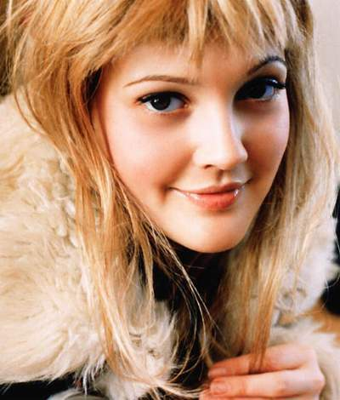
Ethel Barrymore
Drew Barrymore

Slide 8
1800-1900 CONT.
Theatre begins to adopt realism after Ibsen and Chekhov in Europe.
David Belasco brought realism and Edison’s electricity to the theatre of New York and Broadway begins it’s reign. 1895
Drama League of America began push to teach theatre at universities and broaden community theatre (1910)
Theatre Guild was first union of theatre producers

Slide 9
Musical Theatre
Musical theatre derived from Ragtime, Minstrel shows and opera begin to become popular in New York
George M. Cohen and Zigfield Follies with Fanny Brice popularize shows with songs
The greats of Broadway- Irving Berlin, Cole Porter, Rogers and Hart, Rogers and Hammerstein, Lerner and Lowe, Jerome Kern, George Gershwin, Stephen Sondheim, Stephen Schwartz, Andrew Lloyd Weber
Musical theatre becomes the representative theatre of America.

Slide 10
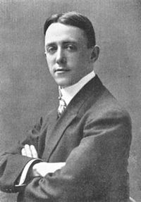
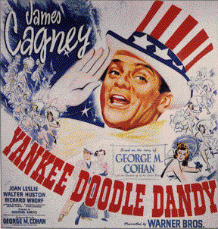
George M. Cohan

Slide 11
YANKEE DOODLE DANDY – GEORGE M. COHAN

Slide 12
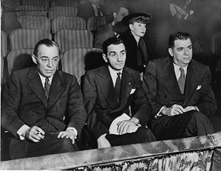
Rogers and Hammerstein
Richard Rogers, Irving Berlin, Oscar Hammerstein

Slide 13
OKLAHOMA-ROGERS AND HAMMERSTEIN

Slide 14
American Legitimate theatre
The Group Theatre – Harold Clurman, Lee Strasberg, Elia Kazan, Sanford Meisner, Clifford Odets (1930’s)
WPA Theatre during the depression
Clifford Odets is first great American Playwright followed immediately by Eugene O’Neil (1930’s and 40’s)
Actor’s Studio in 1947
Arthur Miller, Thornton Wilder, Tennessee Williams emerge with expressionism in the 40’s and 50’s
Edward Albee, Terrence McNally, and Isreal Horowitz emerge in the 60’s and 70’s

Slide 15
A STREETCAR NAMED DESIRE -TENNESSEE WILLIAMS

Slide 16
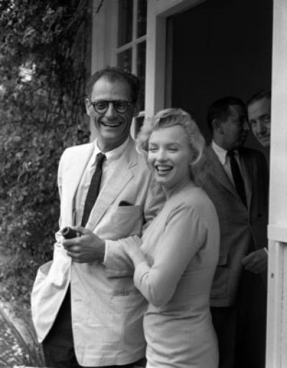
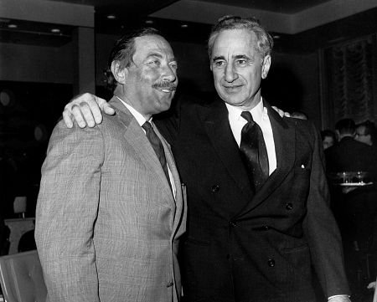
Tennessee Williams and Elia Kazan
Arthur Miller and Marilyn Monroe

Slide 17
Death of a Salesman by Arthur Miller

Slide 18
American theatre today
Musicals are still king, from Jesus Christ Superstart to Lion King to Wicked to Spring Awakening…musicals are big money.
Modern playwrights who challenge convention:
David Mamet, Christopher Durang, Carol Churchill, August Wilson, Lorraine Hansbury, Larry Shue, Horton Foote, David Rabe, Tracy Letts, Sam Shepherd, Neil Simon,

Slide 20
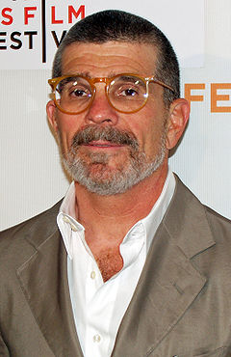
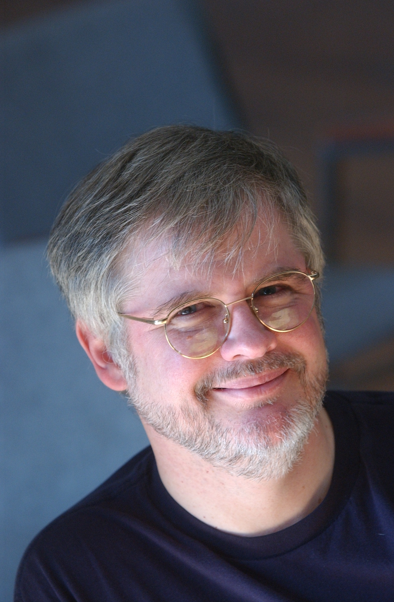
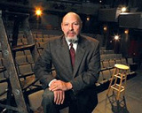
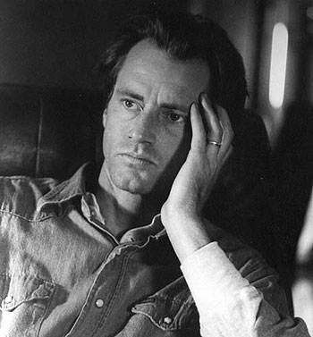
Lanford Wilson
Christopher Durang
David Mamet
Horton Foote
Playwrights Today
Sam Shepherd

Slide 21
Beyond Therapy by Christopher Durang

